Slide 1
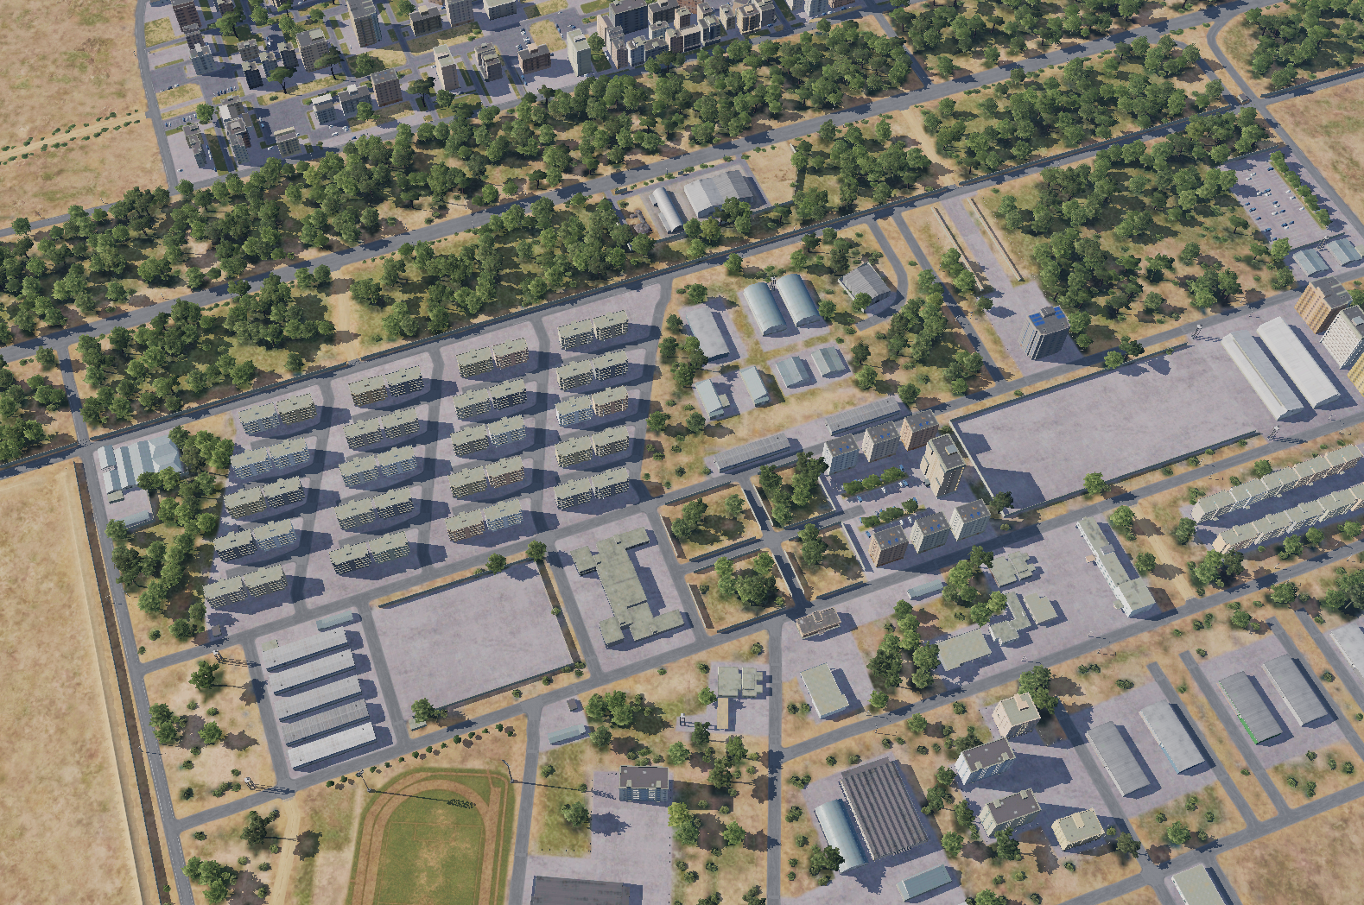

OPARTGT001, Syrian Army HQ building 1
INSERT PICTURE HERE
MAP / WHERE THE TGT IS LOCATED
N
1
1
Weaponeering
DPI 1: N36 10.932 E037 05.540/1427, 1 x 1000 Ibs bomb. It is a concrete building, 2 stories high with a reinforced roof.
Collateral Damage Concern (CDC)
CDC 1, Barracks, CDE 4, 30m N-NW from DPI 1
CDC 2, High-rise buildings, CDE 3, 160m NE from DPI 1
1
3
4
HQ building
5
6
CDC 1, Barracks -CDC 2, High rise buildings
7
8

Slide 2
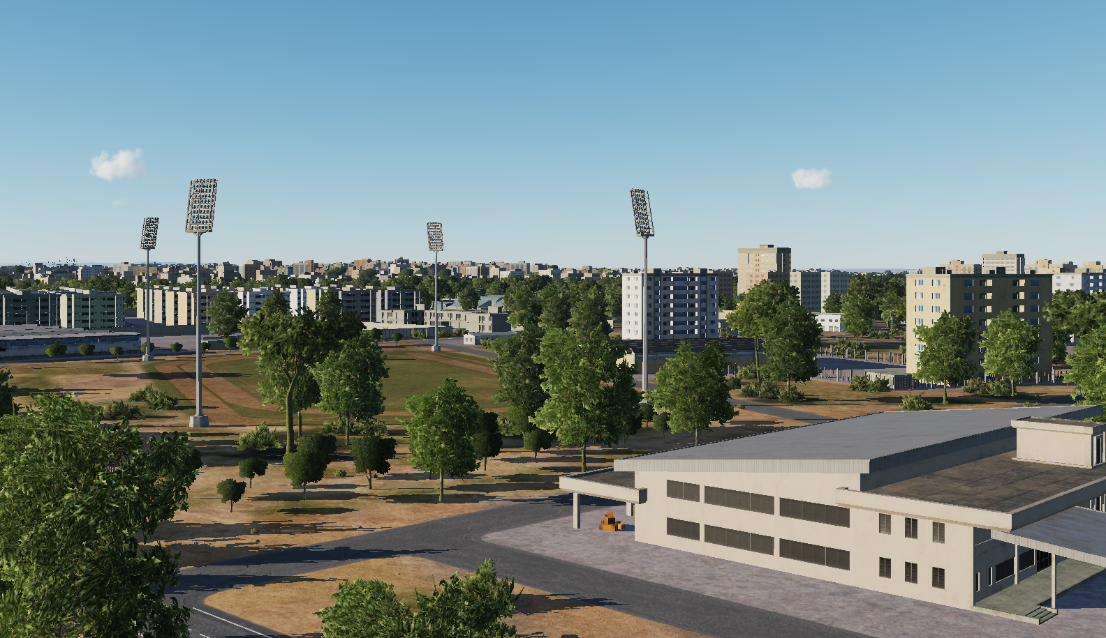
OPARTGT001, Syrian Army HQ building 1, HUMINT
N
N
DPI 1
1
1
2
3
4
5
6
7
8

